Slide 1
A
Presentation On
“Library Management System”
Presented by: Enroll.No:
Bushra Khan EBEON0522606347
Pooja Yadav EBEON0522606589
Dimpal Raghuwanshi EBEON0522604637
Priyanka Deore EBEON0522601610
Saloni More EBEON0522608243

Slide 2
Contents
Introduction
Objectives
Project Scope
Structure of the project
Hardware & Software Requirement
Annotations
Proposed of project
Diagrams
Technologies
Advantages
Application
Future scope of the project
Conclusion

Slide 3
INTRODUCTION
Library management system is a software used to manages the catalog of a library.
This helps to the records of whole transaction of the books available in the library.
Library management handling the records of books and library.
It provides books for large number of readers.

Slide 4
OBJECTIVE
The objective of library management system is to handle the entire activities of a library. The software keeps track of all the information about the books in the library, their complete datails and total number of books available in the library.
The user will find it easy in this automated system rather than using the manual writing system. The system contains a database where all the information will be stored safely.The system is user friendly and error free.
It saves time for the management of library.
Faster search of available books and members than by hand.

Slide 5
PROJECT SCOPE
Any education institute and government office’s can make use of it for providing information about author, content of the available books etc.
The project can further be extended by adding the facility of e-book’s, to overcome the problem of book stock in library.

Slide 6
MODULES
Add New Book Record
View Books
Issue Book
View Issued Book
Return Book
Add New Student Records

Slide 7
STRUCTURE OF THE PROJECT
Admin:
Admin has the authority to add, delete or modify the details of the book available form the system.He also has the authority to provide username and password for the receptionist.He can also add the details off the book.
User Module:
It can show details of books who are listed in library.
Search facility based on different criteria in depth.
Allows user to view quick report like book issue/return etc. in between particular time.

Slide 8
HARDWARE & SOFTWARE REQUIREMENTS:
Hardware Requirement:
RAM : 2GB
Operating System : Windows 10
Hard Disk : 1TB
Software Requirement:
Software IDE : Spring Boot
Language : Java

Slide 9
ANNOTATIONS
@SpringBootApplication: This annotation is used to mark the main class of a Spring Boot application.
@Autowired: @Autowired annotation is applied to the fields, setter method , and constructors. We use @Autowired to mark the dependency that will be injected by the Spring container.
@GetMapping: It maps the HTTP GET requests on the specific handler method. It is used to create a web service endpoint.
@PostMapping: It maps the HTTP GET requests on the specific handler method. It is used to create a web service endpoint

Slide 10
ANNOTATIONS
@Entity: The entity annotation specifies that the class is an entity and is mapped to a database table.
@Repository: Annotation is used to indicate that the class provides the mechanism for storage, retrival,search,update and delete operation on objects.
@Service:Annotation is used to indicate that the class provides some bussiness functionalities.

Slide 11
PROPOSED OF PROJECT
We create a computerized solution for such problem.
This system is specially built to track information about all student and book details.
Search for desired book index system make less time consuming.
Improved customer service through greater access to accurate information.
To provide a friendly environment to maintain the details of books and library members.

Slide 12
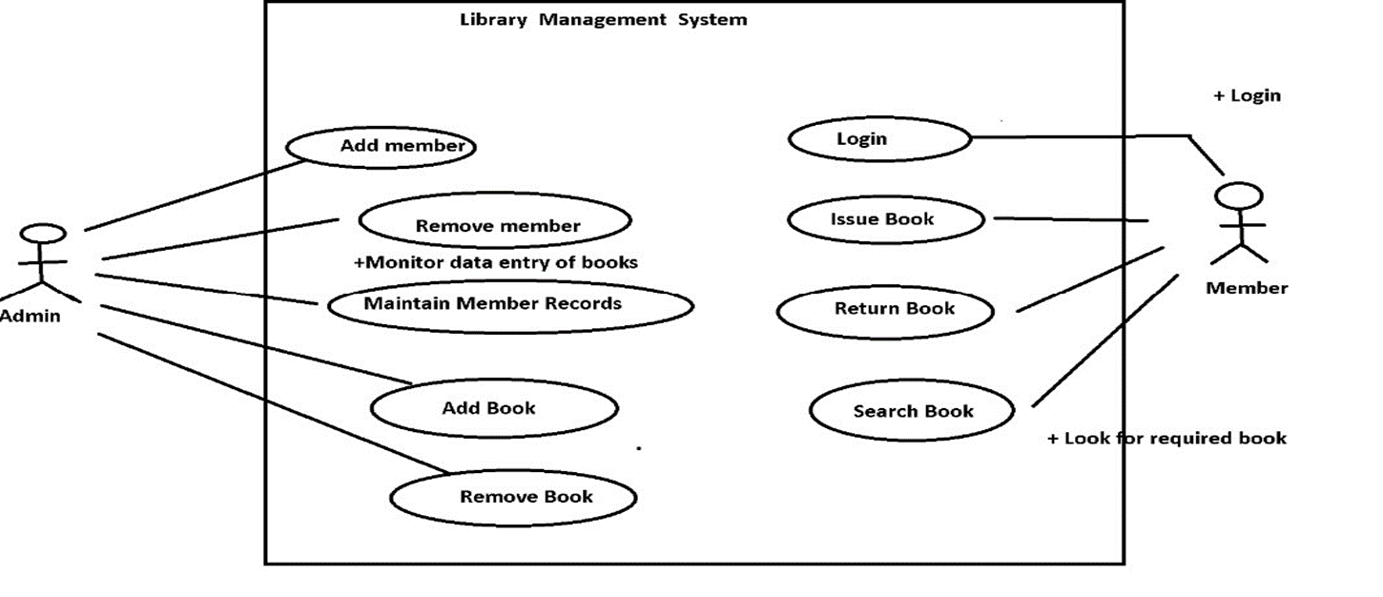
DIAGRAMS:
1]Use case Digram:

Slide 13
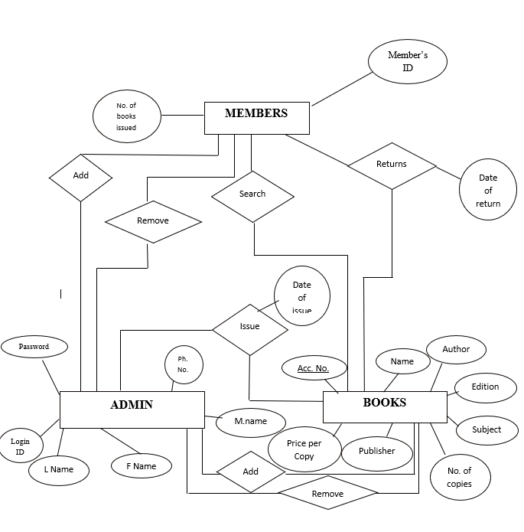
2]ER-Diagram

Slide 14
TECHNOLOGIES
Spring Boot:
Spring boot is a java framework used for develop standalone application.
Need strong knowledge in OOPS & Java concept then only working with spring framework.
Mostly all applications are developed by spring boot, Because it was very secure no one hack the information.

Slide 15
ADVANTAGES
Less handwritten work.
It helps you to minimize your repeated works and take care of the complete functionality of your library.
It is a huge time saver and facilities proper communication among the management staff.
Provide computerizes system for maintaining records.
Avoide Human storage with less computer memory.

Slide 16
APPICATIONS
Database module: This has two functions – Insertion of data and extraction of data with a user-friendly screen.
Report module: For the borrowed books list to display.
Available module: To view the availability of books.
Search Module: search facility for books and members.

Slide 17
FUTURE SCOPE OF THE PROJECT
This project will enhance the book to serve more quickely and efficiently.This software is developed in order to computerized the activities which take more time,if done manually.
Library management system will enable the student and college staff to make things faster and can get information about books ,we can access it quikely.

Slide 18
SNAPSHOTS

Slide 19
CONCLUSION
Library Management System allows the user to store the book details and the customer details.This software package allows storing the details of all the data related to library. The system is strong enough to withstand regressive yearly operations under conditoins where the database is maintained and cleared over a certain time of span.The implementation of the system in organization will considerably reduce data entry,time and also provide readily calculated records.

Slide 20
THANKS !!!

